Slide 1
Chapter Summary
^{Propositional Logic}
^{The Language of Propositions}
^{Applications}
^{Logical Equivalences}
^{Predicate Logic}
^{The Language of Quantifiers}
^{Logical Equivalences}
^{Nested Quantifiers}
^{Proofs}
^{Rules of Inference}
^{Proof Methods}
^{Proof Strategy}

Slide 2
The Foundations: Logic and Proofs
1.1 Propositional Logic
1.2 Applications of Propositional Logic 1.3 Propositional Equivalences 1.4 Predicates and Quantifiers 1.5 Nested Quantifiers 1.6 Rules of Inference 1.7 Introduction to Proofs 1.8 Proof Methods and Strategy

Slide 3
Propositional Logic Summary
The Language of Propositions
Connectives
Truth Values
Truth Tables
Applications
Translating English Sentences
System Specifications
Logic Puzzles
Logic Circuits
Logical Equivalences
Important Equivalences
Showing Equivalence
Satisfiability

Slide 4
Propositional Logic Summary(1.1)
Propositions
Connectives
Negation ¬
Conjunction ∧
Disjunction ∨
Implication→; contrapositive, inverse, converse
Biconditional↔
Truth Tables

Slide 5
Applications of Propositional Logic: Summary(1.2)
Translating English to Propositional Logic
System Specifications
Boolean Searching
Logic Puzzles
Logic Circuits

Slide 6
Propositional Equivalences Summary(1.3)
Tautologies, Contradictions, and Contingencies.
Logical Equivalence
Important Logical Equivalences
Showing Logical Equivalence
Normal Forms
Principal(Major) Disjunctive Normal Form
Principal(Major) Conjunctive Normal Form
Propositional Satisfiability
Sudoku Example

Slide 7
Logical Equivalences
P ∧ T ⇔ P Identity（同一律）
P ∨ F ⇔ P
P ∨ T ⇔ T Domination（零律）
P ∧ F ⇔ F
P ∨ P ⇔ P Idempotency（等幂律）
P ∧ P ⇔ P
∼(∼P)) ⇔ P Double negation（双重否定律）
P ∨Q ⇔ Q∨ P Commutativity（交换律）
P ∧Q ⇔ Q∧ P
(P ∨Q)∨ R ⇔ P∨ (Q∨ R) Associativity（结合律）
(P ∧Q) ∧ R ⇔ P ∧ (Q∧ R)

Slide 8
Logical Equivalences
P ∧(Q∨ R) ⇔ (P ∧Q)∨ (P ∧ R) Distributivity（分配律）
P ∨(Q∧ R) ⇔ (P ∨Q)∧ (P ∨ R)
∼(P ∧Q) ⇔ ∼P ∨∼Q DeMorgan’s laws（德·摩根律）
∼(P ∨Q) ⇔ ∼P ∧∼Q
P ∨(P ∧Q) ⇔ P, P ∧(P ∨Q) ⇔ P Absorption（吸收律）
P ∨∼P ⇔ T Tautology（排中律）
P ∧∼P ⇔ F Contradiction（矛盾律）
P → Q ⇔ ∼P ∨Q Implication（蕴涵等值式）
(P → Q) ∧(Q → P) ⇔ (P↔Q) Equivalence（等价等值式）
P↔Q ⇔ ∼ P↔ ∼ Q Εquivalent negation （等价否定等值式）
(P → Q) ∧(P → ∼Q) ⇔ ∼P Absurdity（归谬论）
(P → Q) ⇔ (∼Q → ∼P) Contrapositive（假言易位）
(P ∧Q) → R ⇔ P →(Q → R) Exportation（输出律）
…..

Slide 9
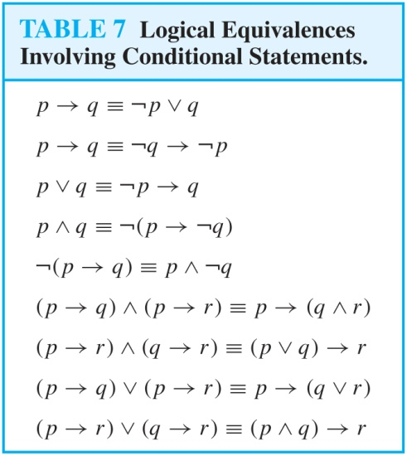
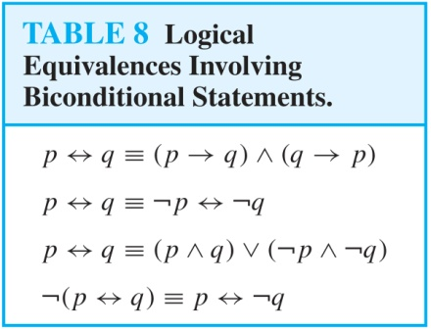
More Logical Equivalences

Slide 10
Predicate Logic Summary
Predicate Logic (First-Order Logic (FOL), Predicate Calculus)
The Language of Quantifiers
Logical Equivalences
Nested Quantifiers
Translation from Predicate Logic to English
Translation from English to Predicate Logic

Slide 11
Predicates and Quantifiers(1.4)
Predicates
Variables
Quantifiers
Universal Quantifier
Existential Quantifier
Negating Quantifiers
De Morgan’s Laws for Quantifiers
Translating English to Logic
Logic Programming (optional)

Slide 12
Nested Quantifiers Summary(1.5)
Nested Quantifiers
Order of Quantifiers
Translating from Nested Quantifiers into English
Translating Mathematical Statements into Statements involving Nested Quantifiers.
Translated English Sentences into Logical Expressions.
Negating Nested Quantifiers.

Slide 13
等值式
~∀xA(x)⇔∃x~A(x)
~∃xA(x)⇔∀x~A(x)
∀x(A(x)∨B) ⇔ ∀xA(x)∨B
∀x(A(x)∧B) ⇔ ∀xA(x)∧B
∀x(A(x)→B) ⇔ ∃xA(x)→B
∀x(B→A(x)) ⇔ B→∀xA(x)
∃x(A(x)∨B) ⇔ ∃xA(x)∨B
∃x(A(x)∧B) ⇔ ∃xA(x)∧B
∃x(A(x)→B) ⇔ ∀xA(x)→B
∃x(B→A(x)) ⇔ B→∃xA(x)

Slide 14
Rules of Inference Summary(1.6)
Valid Arguments
Inference Rules for Propositional Logic
Using Rules of Inference to Build Arguments
Rules of Inference for Quantified Statements
Building Arguments for Quantified Statements

Slide 15
常见推理定律
附加律 Addition A⇒(A∨B)
化简律 Simplification (A∧B)⇒A
假言推理 modus ponens (A→B )∧A⇒B
拒取式 Modus Tollens (A→B )∧¬B ⇒¬A
析取三段论Disjunctive syllogism (A∨B )∧¬B ⇒A
假言三段论 Hypothetical syllogism (A→B)∧(B→C)⇒(A→C)
等价三段论 Equivlence syllogism (A↔B)∧(B↔C)⇒(A↔C)
构造性两难 Constructive dilemma (A→B)∧(C→D)∧(A∨C)⇒(B∨D)
构造性两难(特殊形式) (A→B)∧(¬A→B)∧(A∨¬A)⇒B
破坏性两难 Destructive dilemma (A→B)∧(C→D)∧(¬B∨¬D)⇒(¬A∨¬C)

Slide 16
推理规则
前提引入规则：在证明的任何步骤上都可以引入前提
结论引入规则：在证明的任何步骤上所得到的结论都可以做为后继证明的前提
置换规则：在证明的任何步骤上，命题公式中的子公式都可以用与之等值的公式置换，得到公式序列中又一个公式
分离规则(假言推理) 已知(A→B )，A，则有B。

Slide 17
推理规则
附加前提推理规则(简称CP规则)
如果 ∑ ，A ⇒B，则∑ ⇒ A → B
反证推理规则
如果 ∑ ， ¬ A ⇒F，则∑ ⇒ A

Slide 18
总结
等值式（16组、24条）
幂等律、交换律、结合律、分配律、吸收律；
双重否定律、德●摩根律；
零律、同一律、排中律、矛盾律；
蕴涵等值式、等价等值式、假言易位、等价否定等值式
归谬论
推理定律（9条）
附加、化简
假言推理、拒取式、析取三段论、假言三段论、
等价三段论、构造性两难（特殊形式）、破坏性两难

Slide 19
证明
所谓证明，就是一些公式的序列，其中每一个公式或是已知的前提，或是由前面的公式运用推理规则得出的公式，最后一个公式是结论
前提： A₁,A₂ ,A₃ ,…,A_{k}
结论： B
证明： (1) A₁ 前提引入
(2) A₂ ××××(推理规则)
(3) A₃ ××××
  
(s) A_{k} ××××

Slide 20
Introduction to Proofs Summary(1.7)
Mathematical Proofs
Forms of Theorems
Direct Proofs Assume p is true, and prove q
Indirect Proofs
Proof of the Contrapositive
Assume ¬q, and prove ¬p.
Proof by Contradiction
assumes Q is false，derives a contradiction, usually of the form P  ¬P which establishes¬Q → 0.

Slide 21
Proof Methods and Strategy Summary(1.8）
Proof by Cases Show p↔(a ∨ b), and (a→q) and (b→q).
Existence Proofs ∃x P(x)
Constructive
Nonconstructive
Disproof by Counterexample
Nonexistence Proofs
Uniqueness Proofs
Proof Strategies
Proving Universally Quantified Assertions
Open Problems

Slide 22
Excercise
Which of these sentences are propositions? What are the truth values of those that are propositions?
（a) 2 + 7= 5.
(b) x + 2 = 8.
(c) don’t talk.
(d) If 2+2=3, then pigs can fly.
（e) I’m lying(说谎)

Slide 23
Excercise
In the questions below suppose the variables x and y represent real numbers, and E(x): x is even; G(x): x > 0; I(x): x is an integer.
Write the statement using these predicates and any needed quantifiers.
Some real numbers are not positive.
No even integers are odd.

Slide 24
Excercise
In the questions below suppose the variable x represents students and y represents courses, and F(x): x is a freshman A(x): x is a part-time student T(x,y): x is taking y. Write the statement in good English without using variables in your answers.
F(Mikko).
¬yT(Joe,y)
x(A(x)¬F(x))

Slide 25
Excercise
Show that p→(q→r) and (p ∧ q) →r are logically equivalent.
Show that p→(q→r) ⇔ (p ∧ q) →r
Prove that (q ∧ (p →¬q)) →¬p is a tautology using propositional equivalence and the laws of logic.

Slide 26
Excercise
Find the principal(major) disjunctive normal form of p→(q→r) .
Find the principal(major) conjunctive normal form of p→(q→r) .
Put the statement (∀xP(x)→ ∃ yR(y)) ∨∀xF(x) in prenex normal form.

Slide 27
Excercise
Show that the hypotheses “I left my notes in the library or I finished the rough draft of the paper” and “I did not leave my notes in the library or I revised the bibliography” imply that “I finished the rough draft of the paper or I revised the bibliography”.

Slide 28
Excercise
Let P (x), Q(x), and R(x) be the statements “x is a clear explanation,” “x is satisfactory,” and “x is an excuse,”respectively. Suppose that the domain for x consists of all English text. Express each of these statements using quantifiers,logical connectives, and P (x), Q(x), and R(x).
a) All clear explanations are satisfactory.
b) Some excuses are unsatisfactory.
c) Some excuses are not clear explanations.
∗d) Does (c) follow from (a) and (b)?

Slide 29
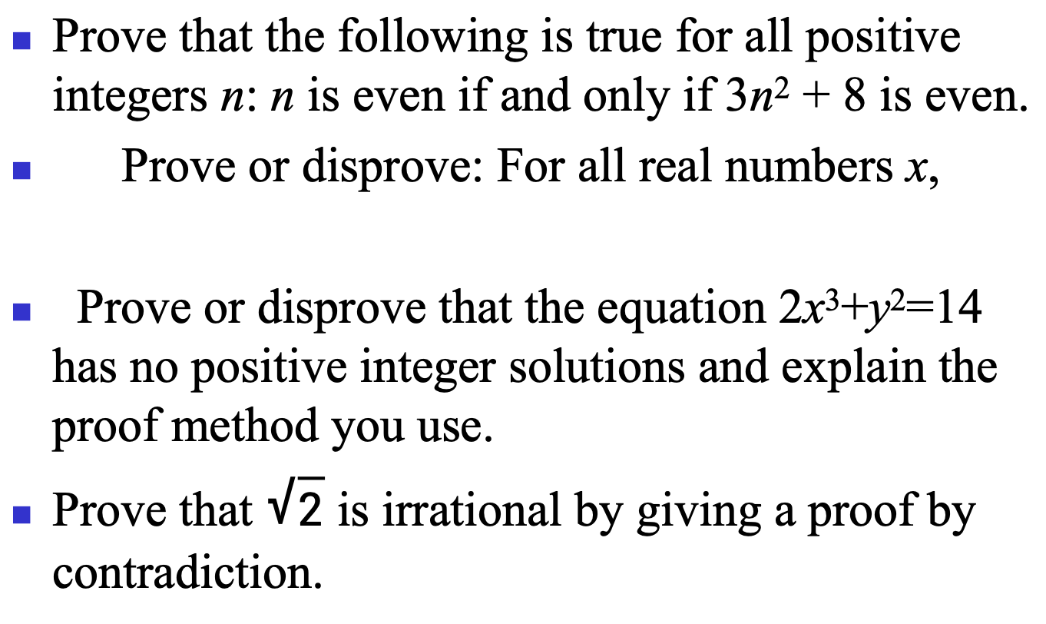
Excercise
Prove that the following is true for all positive integers n: n is even if and only if 3n² + 8 is even.
Prove or disprove: For all real numbers x,
Prove or disprove that the equation 2x³+y²=14 has no positive integer solutions and explain the proof method you use.
Prove that $\sqrt{2}$ is irrational by giving a proof by contradiction.

Slide 30
Proof by Contradiction 1
Example: Use a proof by contradiction to give a proof that √2 is irrational.
Solution: Suppose √2 is rational. Then there exists integers a and b with √2 = a/b, where b≠ 0 and a and b have no common factors (see Chapter 4). Then
Therefore a² must be even. If a² is even then a must be even (an exercise). Since a is even, a = 2c for some integer c. Thus,
Therefore b² is even. Again then b must be even as well.
But then 2 must divide both a and b. This contradicts our assumption that a and b have no common factors. We have proved by contradiction that our initial assumption must be false and therefore √2 is irrational.

